Slide 1
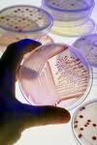
Micro Lab Notes

Slide 2
DAY 1 – MCB 2010C Microbiology
How to get to printed materials:
1) Sign into Valencia’s homepage.
2) Click on “Current Students.”
3) Click on “Faculty Websites.”
4) Click on “G” and then “Gessner, Robert.”
5) You can click on “Course Materials” for the syllabus and all the other printable materials you will need for the course
(only print the materials when you are instructed to do so).

Slide 3
FOR THE SECOND DAY OF CLASS
1) Read and know the syllabus.
2) Print the CHEMISTRY HW (from course materials in the Faculty FrontDoor website). It is DUE in 2 WEEKS.
3) Print or have access to LECTURE PACKET #1 (from course materials on the website).
4) Buy the textbook and your lab manual.
- read pages 1-11 in the lab manual to understand lab safety.
5) Make sure you have a lab jacket for our next lab.
6) Begin learning the first 10 pathogens in the Pathogens Handbook.

Slide 4
KNOW THE FOLLOWING WHEN STUDYING FROM THE PATHOGENS HANDBOOK:
1. The common name and scientific name for all diseases except viruses; for viruses you only need to know their common name.
2. Know what type of organism causes the disease; for example is it a bacterium, a virus, a fungus, etc.
3. Know how the disease is transmitted.
4. Know whether there is a vaccine to prevent the disease and what is the name of the vaccine?
5. From the Key Facts reading, know the major signs and symptoms of each disease, the organ system the disease primarily affects and anything else that is unique about the disease that is in the reading.

Slide 5
Dr. Gessner’s Top Ten Reasons to Study Microbiology

Slide 6
10. MMMM, that bacterial waste product………………………, oh, I mean your cheese or yogurt, tastes good, huh ☺?

Slide 7
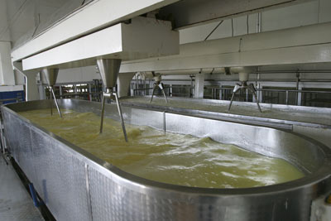
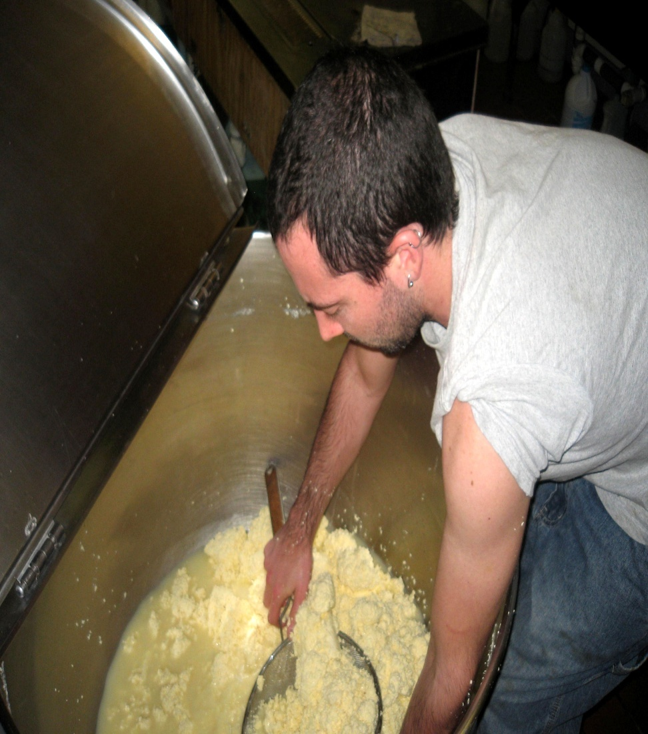

Slide 8
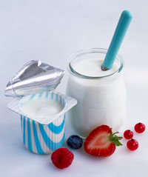


Slide 9
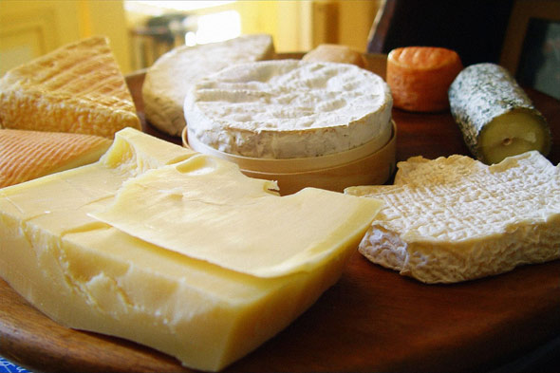


Slide 10
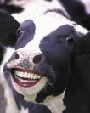
Happy cows like you to eat milk spoiled by bacteria (cheese) ☺

Slide 11
9. That’s it!! Keep leaning back against that movie theatre seat and you can comb the ringworm and lice from each others hair ☺.

Slide 12
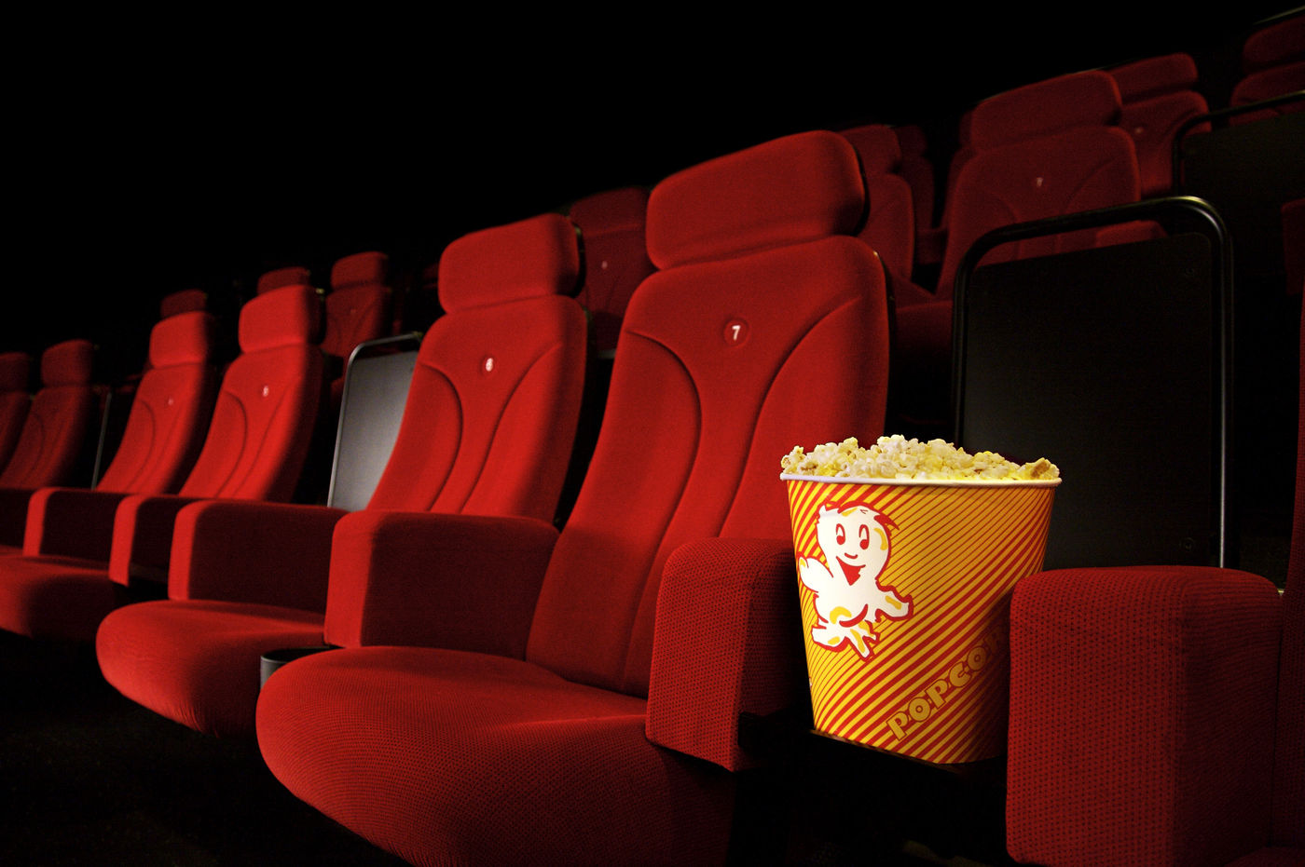

Slide 13
8. You will be the life of any party or social gathering when you can describe the three stages of syphilis ☺.
(YOU MAY WANT TO TELL THEM YOU DON’T KNOW FROM PERSONAL EXPERIENCE)

Slide 14
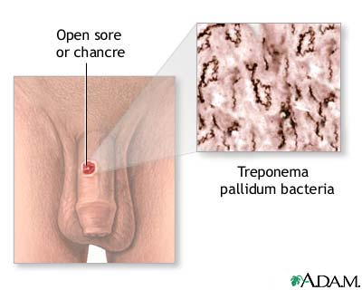
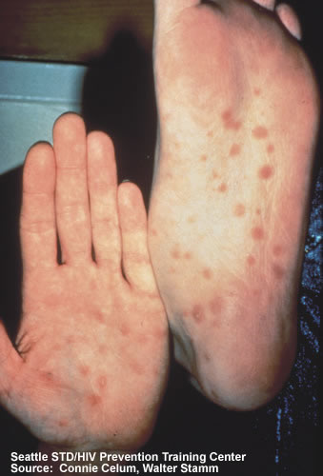

Slide 15
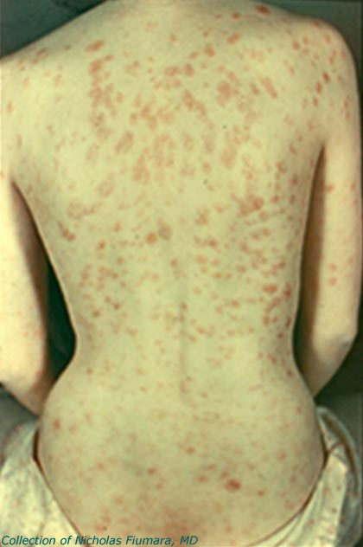
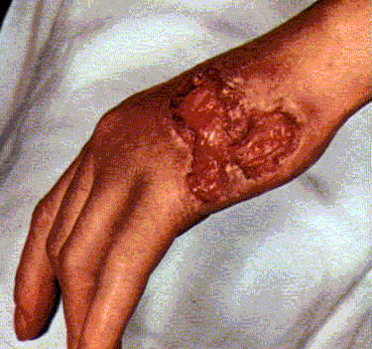

Slide 16
7. Now you will know what you are swimming with at the beach ☺.

Slide 17
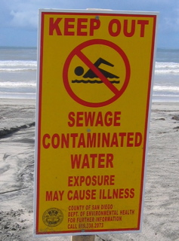

Slide 18
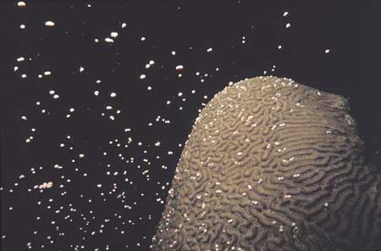
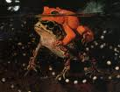

Slide 19
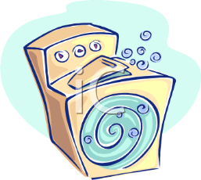
6. You do wear gloves to handle your wet laundry, don’t you? ☺

Slide 20

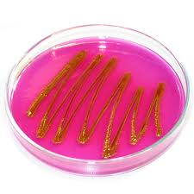
Most bacteria aren’t killed by cold or warm water.
Also, SOAP doesn’t kill most bacteria.
These are E. coli from your intestines.
This is a culture of E. coli taken from the inside of a washing machine.

Slide 21
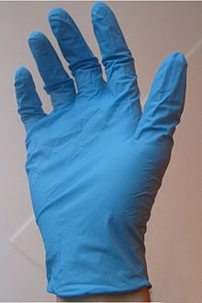
The E. coli comes from your underwear and spreads to all the rest of the clothes in the washing machine!
Could these bacteria lead to illness?

Slide 22
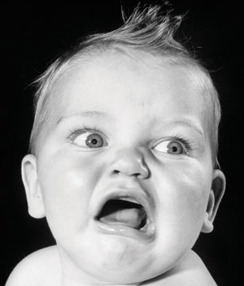
5. I wouldn’t use that bathroom if I were you; that’s where your drinking water may come from ☺.
It’s called “toilet to tap.”

Slide 23
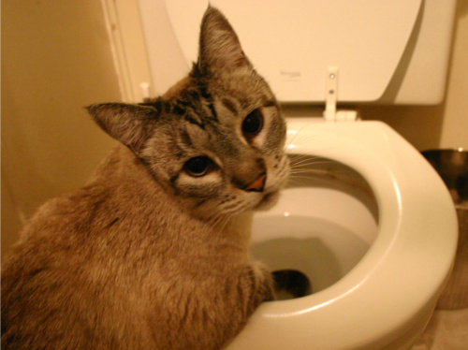
MMM, vintage 2012… a very good year ☺

Slide 24
4. For goodness sakes!!! We are SICK of you medical workers spreading those antibiotic resistant bacteria to your patients, friends and family.
http://www.msnbc.msn.com/id/44334682/ns/health-infectious_diseases/t/hospital-garb-harbors-nasty-bacteria-new-study-says/from/toolbar

Slide 25
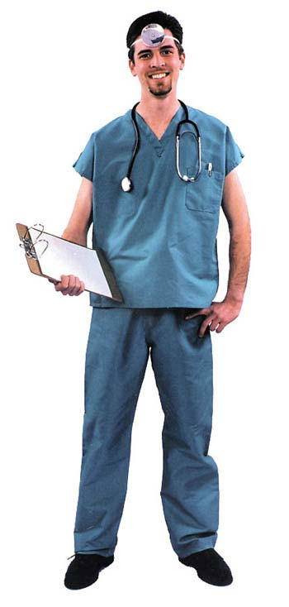
According to the Centers for Disease Control and Prevention, approximately one of every 20 hospitalized patients will contract a healthcare-associated infection. Lab coats, scrub suits, uniforms, gowns, gloves and linens are known to harbor the microbes that cause patient infections.

Slide 26
3. The snot lecture!!! Now you will know why the salad bar has the sneeze guard ☺.

Slide 27
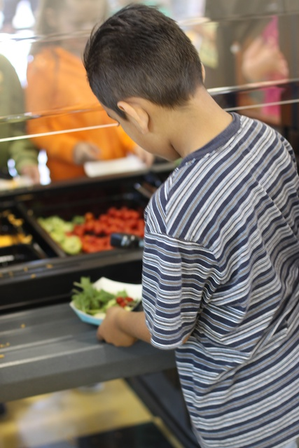

Slide 28
2. With a microscope you can really find out what’s growing between those teeth!!

Slide 29
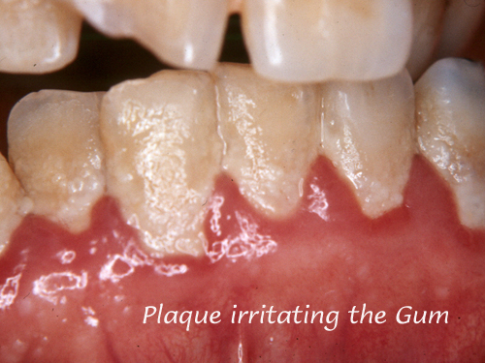

Slide 30
1. EWWWW, you slept with how many millions of living things in your bed last night????

Slide 31
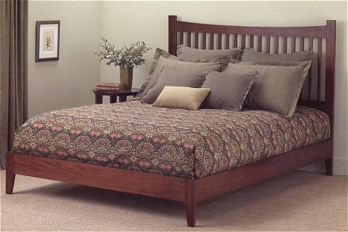
There are millions of house dust mites in your mattress, pillows, bedding, furniture and rugs throughout your home.
Can they pose any problems?

Slide 32
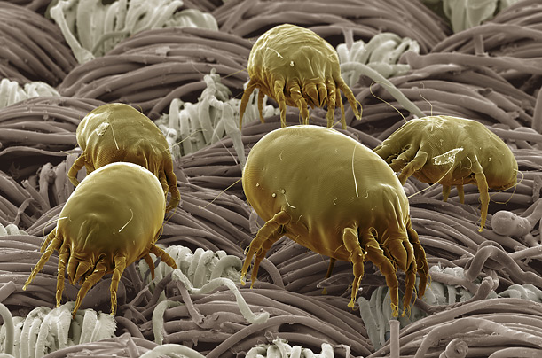

Slide 33
AND AS A BONUS REASON TO STUDY MICROBIOLOGY…..

Slide 34
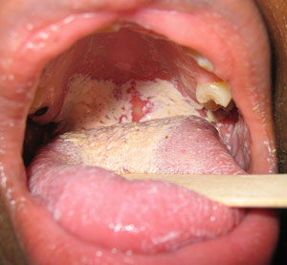
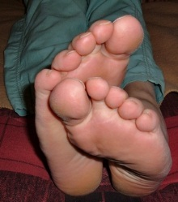
Now, when someone says “you stink!” you can honestly say that it’s not you, it’s your bacteria. ☺

Slide 35
FOR EACH LAB:
- Disinfect your table top before and after each lab period; wash your hands before leaving the lab.
- NO FOOD or DRINKS are allowed in the lab.
- You must have a lab jacket (or suitable substitute for each lab, beginning at next week’s lab).
- The lab manual for this course is required.
- You must wear appropriate footwear (close toe shoes; no high heels) in the lab.
- You will need a Sharpie for every lab.
- You need to remove all personal property, that you cant afford to lose (other than your lab manual), from on and from around your desk.
- You may want to bring colored pencils and/or pens.

Slide 36
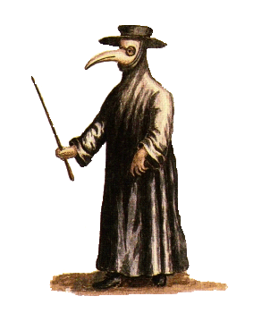
Suggested lab attire ☺

Slide 37
MICROBIOLOGY SCAVENGER HUNT
- disinfectant solution for lab benches - antiseptic hand washing soap
- fire extinguisher; fire blanket - fire alarms
- MSDS folder - emergency shut off valves
- biohazard waste containers - biohazard sharps container
- broken glassware box - “kill cart”
- first aid kit; chemical spill kit - security telephone
- 25°C and 37°C incubators - 4°C refrigerated room
- biological safety cabinet - microscopes
- vortex mixers - 4 pathways to exit the room
- emergency shower and eyewash - Louis Pasteur
- water baths - UV light chamber
- autoclaves (students need to be escorted to observe them and you will be taught how they work and why we need them)
- inoculating loops, flint strikers, plastic pipettes, ethanol, distilled water, sterile cotton swabs, microscope lens cleaner and lens paper, test tube racks, immersion oil

Slide 38
HOW TO USE A MICROSCOPE
1. Plug the microscope in and turn on the light switch; then adjust the light intensity control knob (rheostat) to increase and decrease the amount of light going through the stage.
2. Lower the stage, using the coarse adjustment knob, and then put your slide on the stage, so that it is held in place with the stage clips.
3. Use your mechanical stage knobs, while looking directly at the slide, to position the slide so light is going through the object that you wish to observe.
4. Making sure that the scanner lens is directly above the stage, raise the stage using the coarse adjustment knob while looking through the ocular lenses until you see your image come into view.

Slide 39
5. Using your fine adjustment knob, fine focus the specimen you are looking at on the slide.
6. Before moving to the next higher power of magnification (the low power lens), you must CENTER THE SPECIMEN on the slide in the field of view. Do this while looking through the oculars at your specimen by using your mechanical stage knobs.
7. Rotate the revolving nosepiece so that the LOW power objective lens is now above the slide. Your microscopes are PARFOCAL; do you need to lower the stage when trying to find your specimen as you move to a higher power objective lens, so you don’t hit the higher power lens with the slide on the stage?

Slide 40
8. FOCUS the specimen on the slide using your fine adjustment knob.
9. Center the specimen on the slide, under low power, using the mechanical stage knobs.
10. Rotate the nosepiece to the HIGH POWER objective lens and focus the specimen by only using the fine adjustment knob.
11. Be sure you can identify each of the microbes that you are supposed to observe in this lab.

Slide 41
MICROSCOPE STORAGE:
1. The rheostat wheel needs to be set to the lowest light intensity.
2. The on/off switch is then turned off.
3. The stage needs to be set slightly above its lowest position.
4. The mechanical stage should be centered.
5. The objective lenses are clean and free from any oil buildup, properly cleaned with only lens paper and lens cleaner. If using the oil immersion lens make sure the lens is oil free when the students check out.
6. The objective lenses are set so the 4X lens is directly above the stage.
7. The electrical cord is wrapped properly.
8. The arm is facing you when the microscope is replaced in the storage cabinet.
9. The cabinet door closes properly when the microscope is in place.

Slide 42
LAB 1-5 STREAK PLATE METHODS of ISOLATION
Sample the following:
Table 1 – sink faucet
Table 2 – sponges at sink
Table 3 – men's urinal
Table 4 – women’s toilet bowl
Table 5 – bottoms of purses and book bags
Table 6 – water fountain spigot
Table 7 – bottoms of your shoes

Slide 43
Lab 3-3: Examination of Eukaryotic Microorganisms
Kingdom Eubacteria:
Oscillatoria (cyanobacterium – a prokaryote)
Kingdom Protista: subkingdom protozoa:
Amoeba proteus
Paramecium caudatum
Giardia lamblia √
Human blood with Plasmodium sp. (malarial parasites) √ subkingdom algae:
Volvox
Spirogyra
Diatoms
Euglena (can be autotrophic or heterotrophic)

Slide 44
Kingdom Fungi:
Saccharomyces (yeast)
Mold Types slide has the following 3 molds: √
Penicillium
Rhizopus
Aspergillus
Kingdom Animalia:
Dipylidium caninum (dog tapeworm)
Pediculus humanis corporis (human body louse – an insect)
KNOW to which kingdom each of these organisms belong.

Slide 45

What is this?

Slide 46
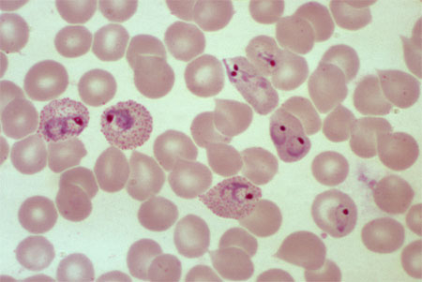
What is this?

Slide 47
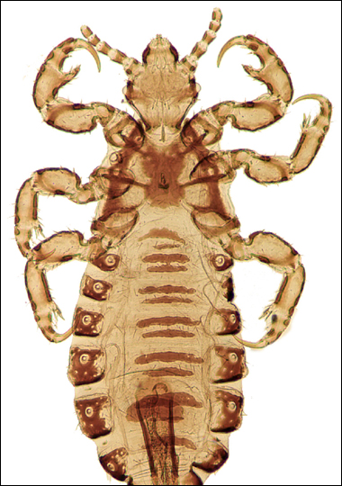
What is this?

Slide 48
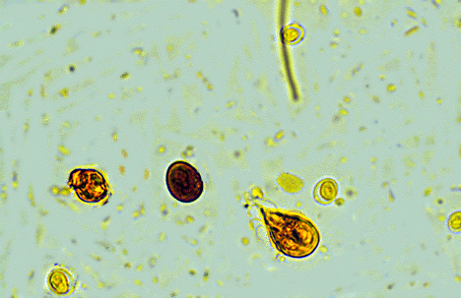
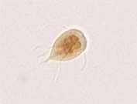
What is this?

Slide 49
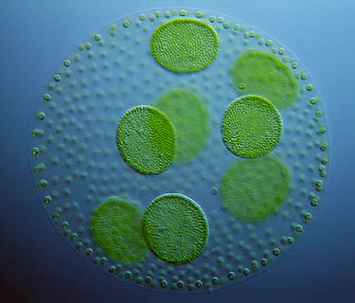
What is this?

Slide 50
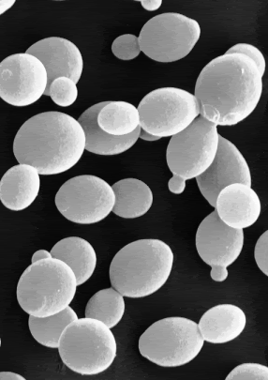
What is this?

Slide 51
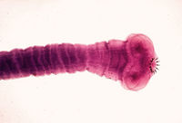

What is this?

Slide 52
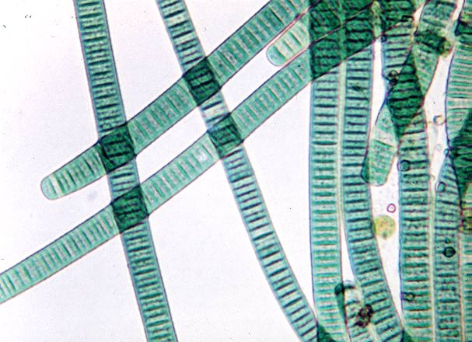
What is this?

Slide 53
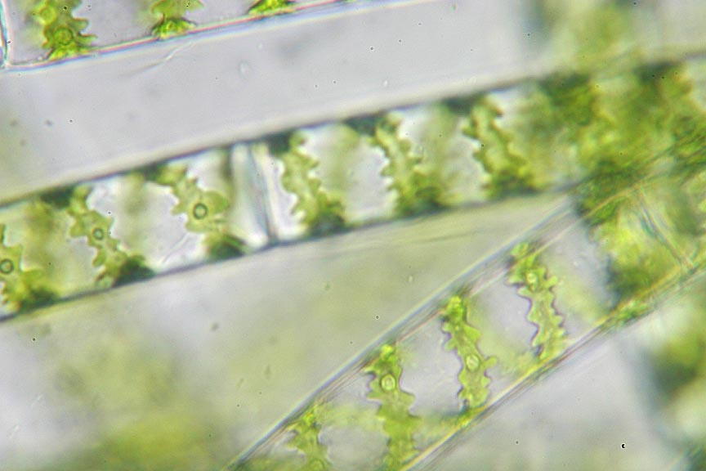
What is this?

Slide 54
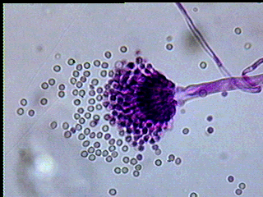
What is this?

Slide 55
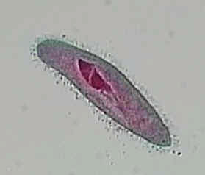
What is this?

Slide 56
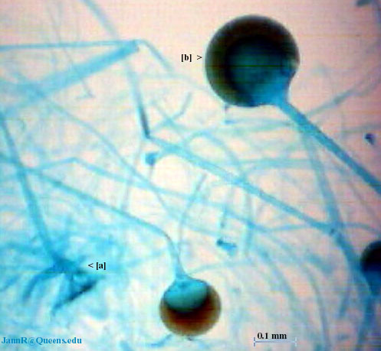
What is this?

Slide 57
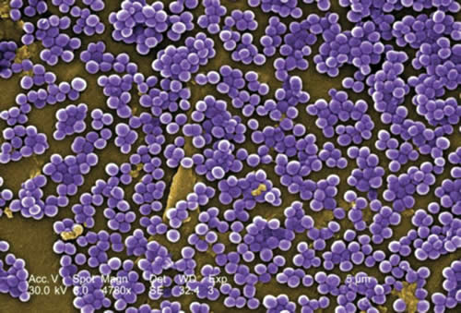
What is this?

Slide 58
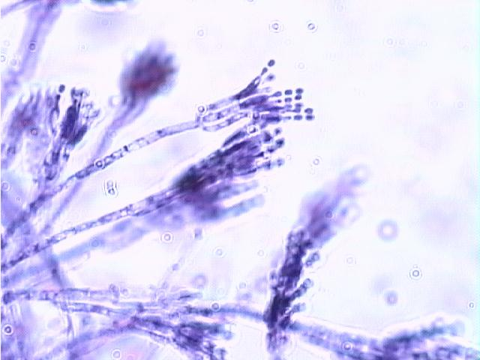
What is this?

Slide 59
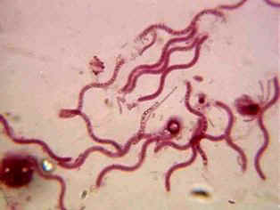
What is this?

Slide 60
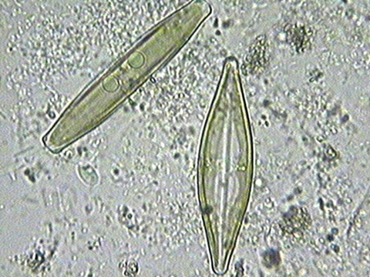
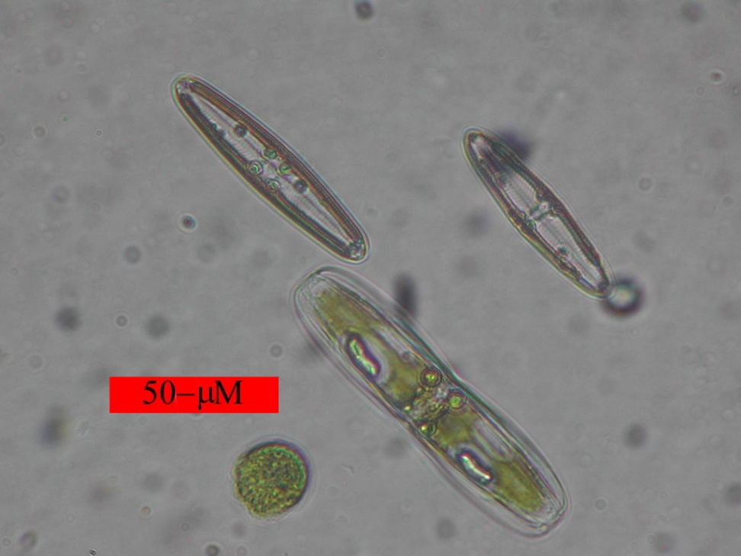
What is this?

Slide 61
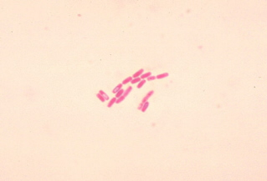
What is this?

Slide 62

What is this?

Slide 63
MICROBIOLOGY STUDENTS
BEFORE LEAVING, PLEASE BE SURE TO:
Have your microscope checked out (if you used one) by your instructor to be sure that all oil is removed from the lenses and that the microscope is ready for storage in the cabinet.
Clean slides as directed by your professor.
AND…………………………………….

Slide 64
Remove all markings from used glass test tubes, using alcohol wipes. When finished, put the contaminated test tubes in the kill cart, filling any existing test tube racks first.
Discard all Petri dish cultures in the biohazard waste containers (orange lined trash cans).
Return all equipment (loops, wires, flint strikers, immersion oil, lens paper) to your drawer.
Put seats under the lab tables, disinfect tabletops and wash your hands.
Thank you for cleaning up after yourselves ☺

Slide 65
How to Check Midterm Grades in Atlas
- Access your Atlas account
-Select the School Services tab
- Click on Registration, Records and Financial Aid
- Click on Student Records
- Click on Midterm Grades

Slide 66
Using Lab 9-1 in your Microbiology Lab Book, identify what the following microbe would be:
PRG – yellow broth; bubble in Durham tube
PRS – yellow broth
PRM (mannitol) – yellow broth
MR – red broth
VP – copper/brown layer on broth
Citrate – green slant
Lysine – purple broth
Ornithine – purple broth
Urea – orange broth
Nutrient Gelatin – solid deep
DNase – no zone of clearing
H2S – no black precipitate (ppt.) in SIM
Motility – fuzziness around stab in SIM
Indole – cherry red layer on top of SIM
See me to determine whether you have correctly identified the bacterium.

Slide 67
UV Light Lab
- UV C rays (254 nm) can kill bacteria
- The more the time of exposure, the greater the killing effect; spore formers are more resistant than non-spore formers.
- Fungi are less affected by UV C rays than are bacteria
- UV rays are very poorly penetrating and were blocked by the plastic Petri plate lid (the control plate with no UV exposure and the 5 minute lid on plate had identical microbial growth)
- How do UV C rays kill bacteria? By creating THYMINE DIMERS which block DNA polymerase from allowing DNA replication and which block RNA polymerase from allowing the transcription of a gene. (LAB 8-2)

Slide 68
THE ELISA TEST (Enzyme Linked Immunosorbent Assay)
Detects antibodies in your blood to determine if you have been exposed to a disease.
Can be used to detect diseases (including HIV, SARS, West Nile encephalitis, Lyme disease, Avian flu).
Can be used in pregnancy and ovulation test kits, detecting illegal drugs (marijuana and cocaine), testing indoor air quality, and to determine if foods have been labeled properly.
Remember that each antibody reacts specifically with only one antigen.
Rapid results!!
(PRINT pp S-1 to S-4 from the pdf file in Faculty Frontdoor)

Slide 69
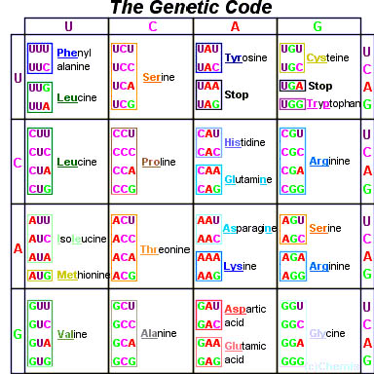
SOLVE THIS PROBLEM:
From the DNA strand
3‘AGGCTTCGA5’
a) Determine the mRNA that is transcribed from it.
b) Determine the tRNA anticodons that are complimentary to that mRNA.
c) Determine the 3 amino acids that the DNA coded for to make a polypeptide chain.

Slide 70
AND DO THIS PROBLEM:
A mutation occurs to cause
3‘AGGCTTCGA5‘ to be changed to
3‘AGCGCTTCGA5‘.
What type of mutation occurred?
What will the 3rd amino acid coded for after the mutation?

